Slide 1

Company Internal Chatbot with RBAC
Secure Retrieval-Augmented Generation System
Natural Language Processing | Information Retrieval | Security
Sai kumar garlapati
B.Tech Computer Science Engineering
Notes:
“This project is a secure internal chatbot designed for organizations.
Unlike normal chatbots, it doesn’t just answer questions — it strictly controls who can see what, based on role and department.
The focus is not just AI intelligence, but AI safety, access control, and real-world usability.”

Slide 2
Project Overview
Problem Statement
Organizations store critical information across documents, reports, and internal data sources, but accessing the right information securely using natural language remains difficult.
Solution
A secure, role-aware AI chatbot that answers employee queries using internal company data while strictly enforcing access permissions.
Core Idea
Retrieval-Augmented Generation (RAG) + Role-Based Access Control (RBAC)
Notes:
“At a high level, this is an internal company chatbot.
Employees ask questions in natural language, and the system answers only using authorized internal documents.
What makes it different from a normal chatbot is that every answer is filtered by role.
A finance employee cannot see HR data.
An employee cannot see leadership-level documents.
So the intelligence comes from AI, but the trust comes from architecture.”
Emphasize trust + control.

Slide 3
Project Objectives
Enable natural language access to internal company knowledge
Ensure strict role-based access control across all queries
Prevent information leakage across departments
Provide traceable answers with source attribution
Non-Goals
Not a public chatbot
Not trained on open internet data
Not replacing human decision-making
Not focused on model fine-tuning
Notes:
“Once the problem was clear, the objectives were very deliberate.
I didn’t want to build another chatbot.
I wanted to build a company-grade assistant.
Every answer should be:
grounded in real documents
permission-aware
and traceable back to its source.
If an HR user asks a finance question — the system should say no, not hallucinate.”
That line lands well. Pause for effect.

Slide 4
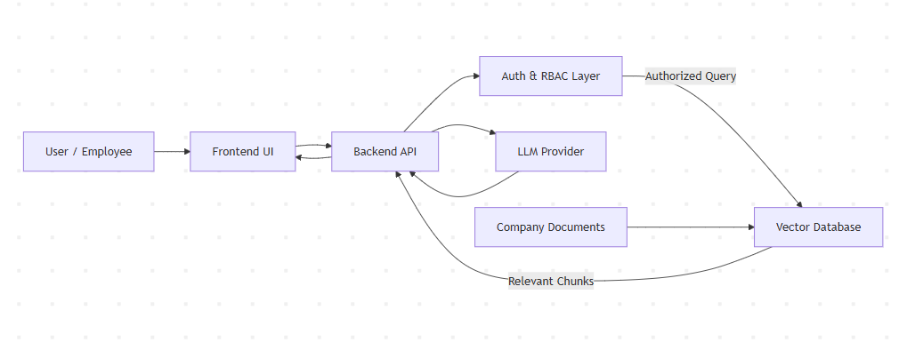
High-Level Architecture
Notes:
“At a high level, the system is intentionally modular.
I separated concerns so that security decisions are never mixed with language generation.
The user never directly interacts with the documents or the model.
Every request flows through authentication, authorization, retrieval, and only then generation.
This makes the system easier to reason about, debug, and secure.”

Slide 5
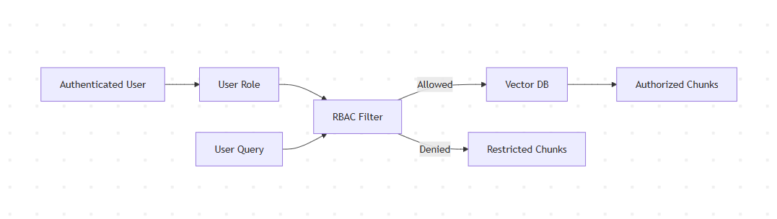
Role-Based Access Control (RBAC)

Slide 6
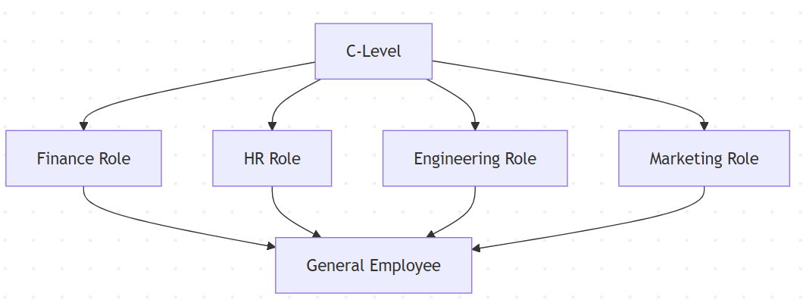
Role Hierarchy & Access Scope
Access is based on document ownership, not user intent
Departments: Finance, HR, Engineering, Marketing
General: Policies, Handbook, Company-wide info
Role | Access Scope
C-Level | All departments + general
Department Roles | Own department + general
Employee (General) | General only

Slide 7
RAG PIPELINE & QUERY FLOW
From question → secure answer → cited sources
User submits a natural language query
User role is validated (JWT + RBAC)
Query is normalized
Relevant documents are retrieved (role-filtered)
Context is injected into LLM prompt
Answer is generated with sources
Key Principle:
The LLM never sees unauthorized data.

Slide 8
SECURITY, RBAC ENFORCEMENT & MISUSE PREVENTION
Security by Design — Not by Prompt
Multi-layer protection model
JWT-based authentication
Role-Based Access Control (RBAC)
Pre-LLM filtering (hard boundary)
Source attribution & auditability
Zero Trust Principle:
No role, no document, no exception.

Slide 9
TESTING STRATEGY & ROLE VALIDATION
How We Tested the System
Multi-angle validation approach
✅ Role-based access tests
✅ Cross-department misuse attempts
✅ Query ambiguity handling
✅ LLM misuse & prompt injection attempts
✅ Retrieval relevance checks
Testing focus:
Correct answers are useless if access is wrong.
Role | Query | Expected Outcome
Employee | “Show salaries” | ❌ Blocked
HR | “Performance ratings” | ✅ Allowed
Finance | “HR records” | ❌ Blocked
C-Level | “All departments” | ✅ Allowed
Any | Prompt injection | ❌ No effect

Slide 10
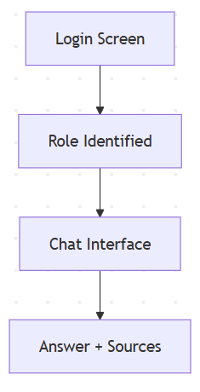
FRONTEND EXPERIENCE & DEMO FLOW
Streamlit-Based Secure Chat Interface
Designed for clarity, not complexity
🔐 Login with role-based authentication
🧑‍💼 Role visibility on UI
💬 Conversational chat interface
📄 Source-backed responses
🧾 Transparent citations per answer
Same system. Different experience per role.

Slide 11
PERFORMANCE, LATENCY & SCALABILITY
Performance Characteristics
Designed for fast, secure internal usage
⚡ Vector search latency: sub-500 ms
🧠 LLM call isolated to final step
📦 Batched embeddings & indexed chunks
🔁 Stateless backend APIs
Security checks add negligible overhead.

Slide 12
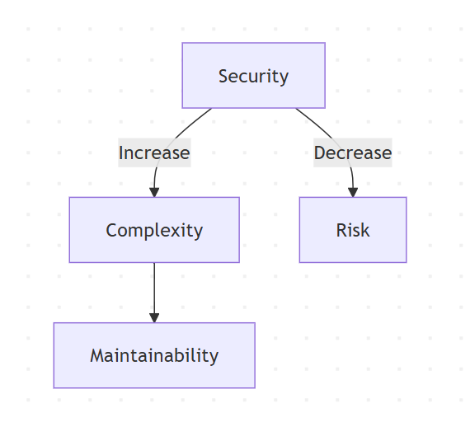
CHALLENGES & DESIGN TRADE-OFFS
Key Challenges Encountered
🔐 Enforcing RBAC before LLM invocation
📄 Handling mixed document formats (MD + CSV)
🧠 Preventing over-retrieval across departments
🤖 LLM quota & provider limitations
🧪 Testing misuse and edge cases
Every design decision involved a trade-off.

Slide 13
FUTURE SCOPE & ENHANCEMENTS
What Can Be Extended Next
🧠 Advanced query normalization & intent detection
🗂️ Cross-department shared document policies
📊 Analytics on query patterns & access attempts
🔁 Feedback loop for retrieval quality
🧩 Plug-in support for more LLMs (open-source, on-prem)
Built as a foundation, not a one-off.

Slide 14
CONCLUSION & KEY TAKEAWAYS
What This Project Demonstrates
Secure, role-aware information access
RAG-based answers grounded in real data
Strict RBAC enforced before AI reasoning
Transparent, auditable responses
Modular, extensible architecture
This is not a chatbot demo —
it’s a secure internal knowledge system.

Slide 15
THANK YOU & Q&A

